Slide 1
Vision-based fall detection system for improving safety of elderly people
Fouzi Harroua , Nabil Zerroukib , Ying Suna , Amrane Houacineb
IEEE Instrumentation and Measurement Society 2017

Slide 2
Introduction
multivariate exponentially weighted moving average (MEWMA)
MEWMA statistic fails to differentiate real falls from some like-fall gestures
SVM fall detection dataset(URFD,FDD)

Slide 3
advantage of using the MEWMA chart
offers a better sensitivity in detecting falls
low-computational cost
+
SVM adjust to perform as linear or nonlinear algorithm by using nonlinear kernels.
MEWMA-SVM presents a high accuracy

Slide 4
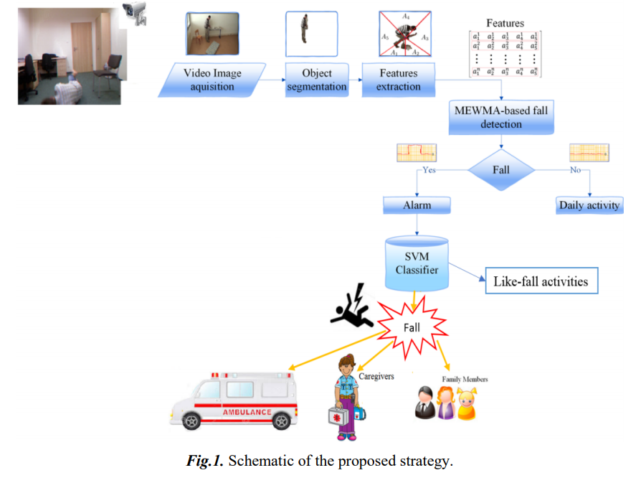
A vision-based fall detection and classification strategy

Slide 5
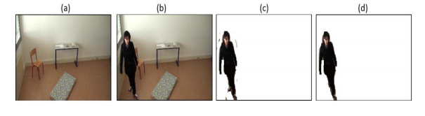
background subtraction procedure

Slide 6
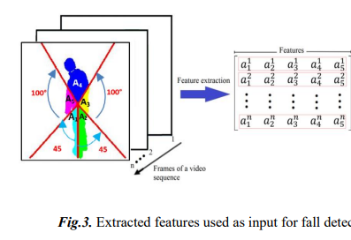
five lines from the silhouette’s center of gravity

Slide 7

A MEWMA-based Fall Detection Strategy
time-weighted average of all previous observations
widely used to monitor industrial processes for many years
able to detect small shifts

Slide 8
one disadvantage of the MEWMA
anomaly detector is the lack of ability to discriminate the detected fall from false falls (i.e., fall-like).
>>>falls classification based on the SVM algorithm

Slide 9
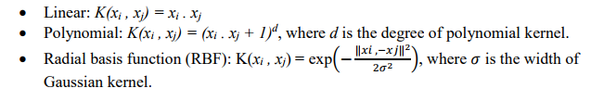
SVM-based fall classification
three kernels were tested namely:
linear, polynomial, and radial basis function.

Slide 10
Experiments and Results
Data description
UR fall detection Database (URFD)
Fall Detection Database (FDD)
compared with some powerful algorithms namely:
KNN, neural network, and finally naïve Bayes classifier

Slide 11
the false detection rate (FAR)
the miss detection rate (MDR)
smaller the FAR and MDR are better
MEWMA threshold value is found to be h = 13.82
Notes:
FAR은 전체 비정상 데이터의 수에 대해 비정상 (오경보)으로 잘못 판단 된 정상 관측 수입니다.
MDR은 총 이상에 대해 정상으로 잘못 분류 된 이상 (누락 된 탐지)의 수입니다.

Slide 12
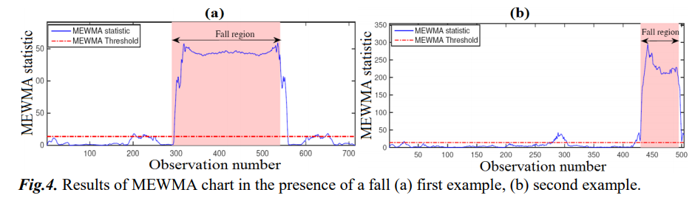
Detection results

Slide 13
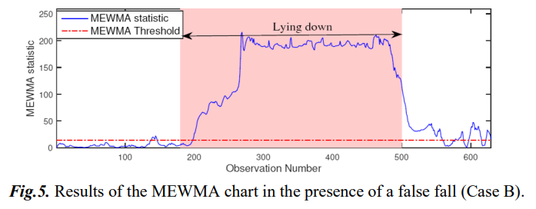
MEWMA chart cannot discriminate real falls from fall-like actions like lying down.

Slide 14
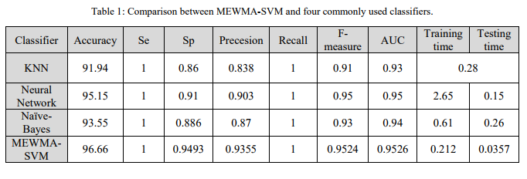
Classification results

Slide 15
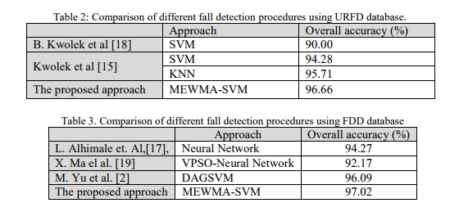

Slide 16
Conclusion
Future work
heart rate and blood pressure
accelerometers or gyroscope

